Slide 1


Reporting service (RS)

Slide 2

Team: PRIUS
Reporting service
Dinh Thang Nguyen
Ha Vu Duy Nguyen
Huy Toan Nguyen
Van Ty Pham

Slide 3

Agenda
Overview about RS
architecture
Technology stack
Class diagram & sequence diagram
demo

Slide 4

Reporting service
Subscribes to the topic “SS_...” – scoring service
Serves the Client : Provides all values published by SS in the shape of a table - chart
Informs the user of all current Sensitivity Index values
Allows export of the listed information in CSV formatted file

Slide 5
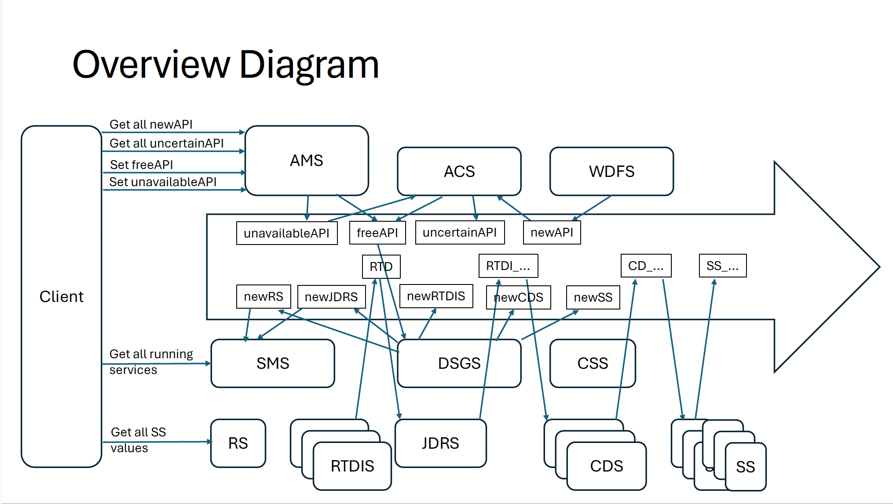
What we do in whole picture
SS_..
Web app
RS
iOS

Slide 6
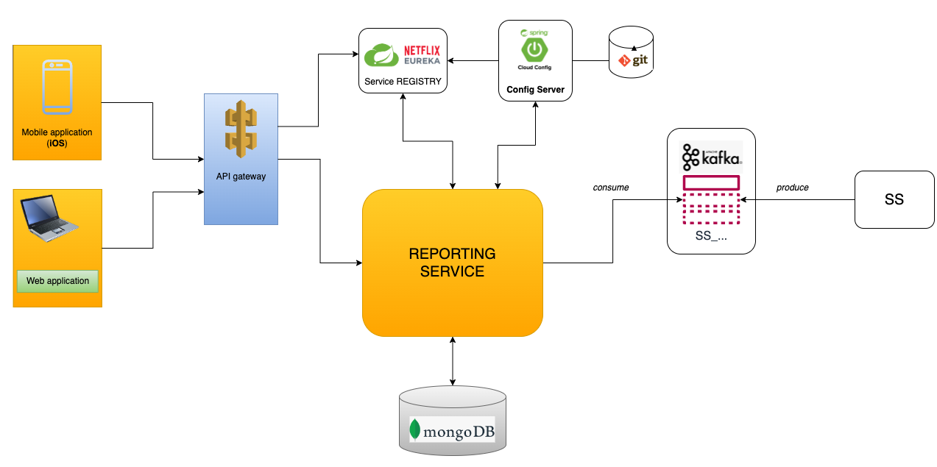
Microservice architecture

Slide 7
Network diagram

Slide 8
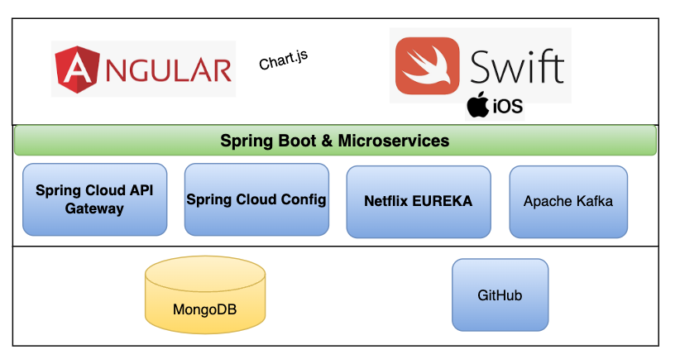
Technology stack

Slide 9
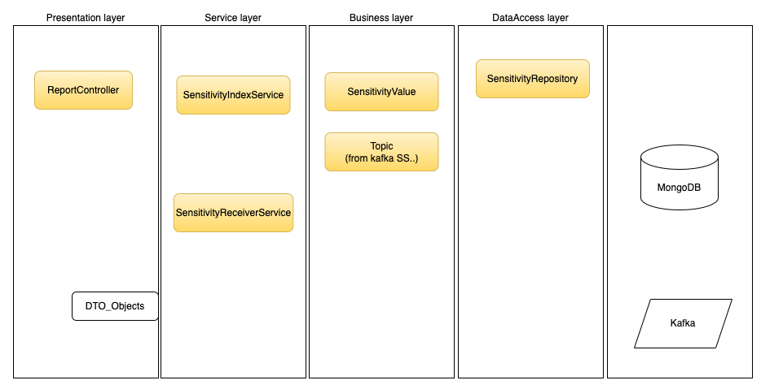
Layers in microservice - RS

Slide 10
Class diagram

Slide 11
Sequence diagram

Slide 12
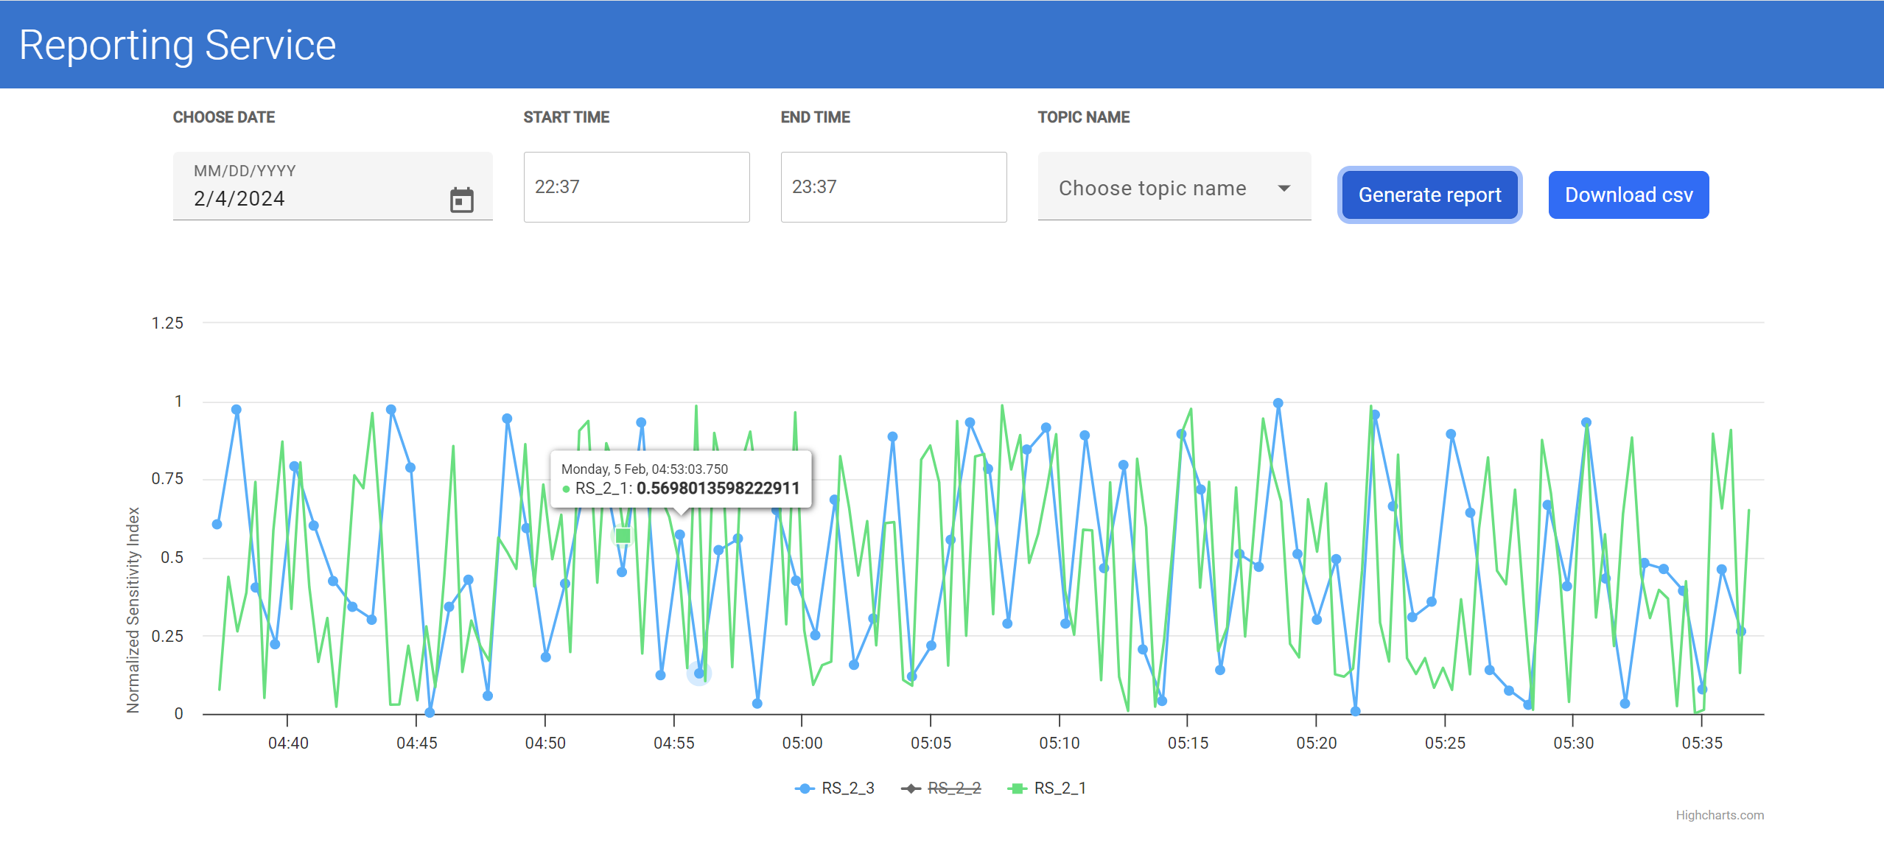
demo

Slide 13

Q&A

Slide 14

Thank you!

